Slide 1





Face Emotion Recognition
CNN VS MobileNetV2
Deep Learning
2023-2024 M2 Data & AI
Presented by:
Ali ABDALLAH
Mohamad Ali GHADDAR
Juste BANKUMUKUNZI

Slide 2
Overview of Deep Learning
Deep learning is a subset of machine learning that utilizes artificial neural networks with multiple layers to learn and extract features from data.
Deep learning is particularly effective for face emotion recognition due to its ability to automatically learn features from raw data.

Slide 3

INTRODUCTION
Face emotion recognition involves the identification and analysis of human emotions from facial expressions using deep learning techniques.
Emotion detection has numerous applications including human-computer interaction, market research, and mental health monitoring.

Slide 4

Dataset Selection
Datasets play a crucial role in training accurate deep learning models based on their size and diversity.
Examples of FER datasets used in include CK+, FER2013, and RAF-DB, each with its own characteristics and challenges.
We chose the FER2013 Dataset for our code as it provides a large data to train our models and a variety of emotions for FER.
The training set consists of 28,709 examples and the public test set consists of 3,589 examples.

Slide 5

Preprocessing Techniques
Preprocessing helps enhance the quality of input data and improve model performance.
For our Dataset we Rescaled the data, preformed data augmentation, split the data into training and validation sets.

Slide 6


Model Architecture
First model: Convolutional Neural Network (CNN), We applied Padding, Activation, Maxpooling, Batch normalization,
Dropout and Adam
Second Model: MobileNetV2 which is a model in keras’s API, We applied Batch normalization, Dropout, flatten and added repeat channels for this model.

Slide 7


Training Process
The dataset is split into training & validation sets and was trained on 100 epochs for both models.
To evaluate the models, we plotted the score of accuracy for training and validation, with the training and validation loss to see how our model preformed on all epochs, then we plotted the confusion matrix to get the comparison between real results and the predicted results.

Slide 8
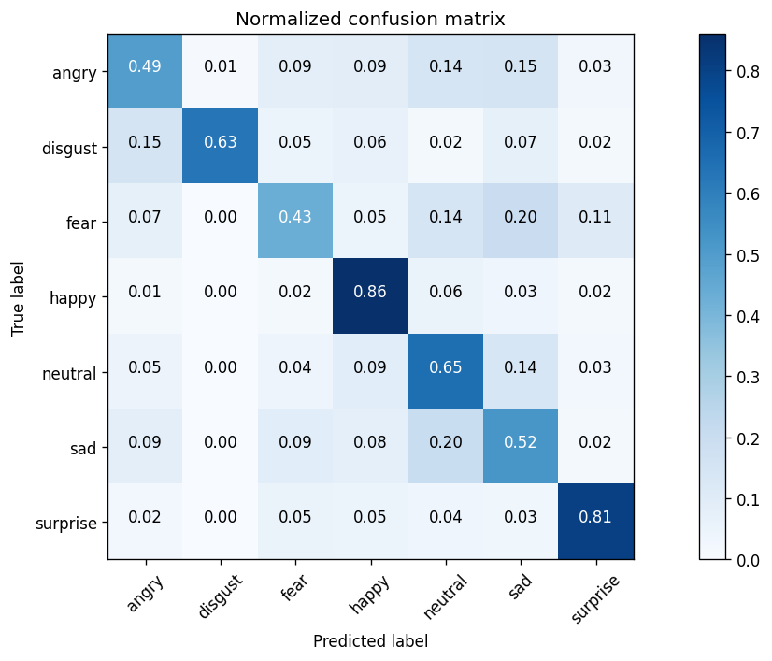
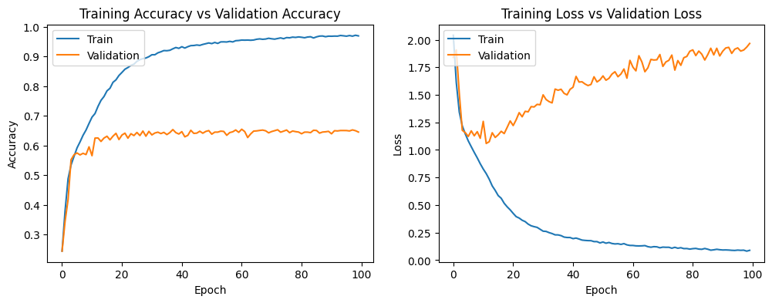
CNN Evaluation
Plots for accuracy and loss & Confusion matrix
Accuracy : Training : 96% | Validation : 64%
Best Predictions : Happy 0.86 | Surprise 0.81

Slide 9
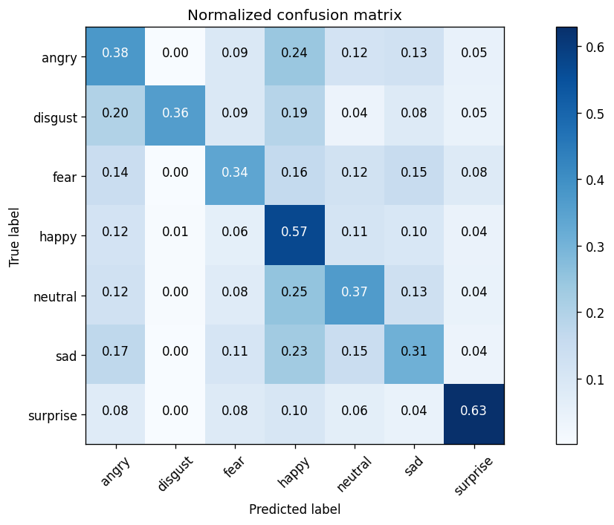
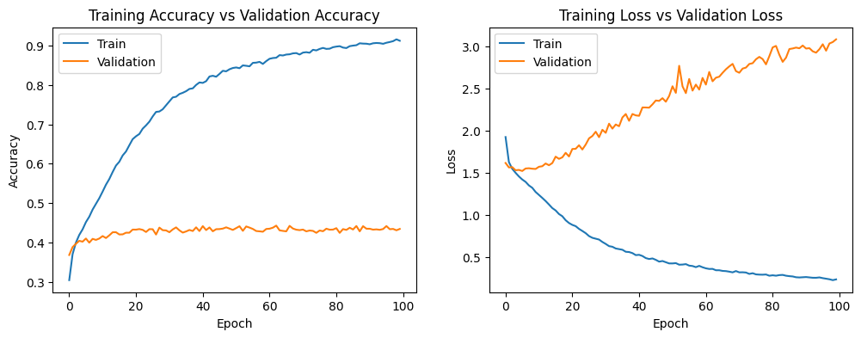
MobileNetV2 Evaluation
Plots for accuracy and loss & Confusion matrix
Accuracy : Training : 92% | Validation : 42%
Best Predictions : Surprise 0.63 | Happy 0.57

Slide 10
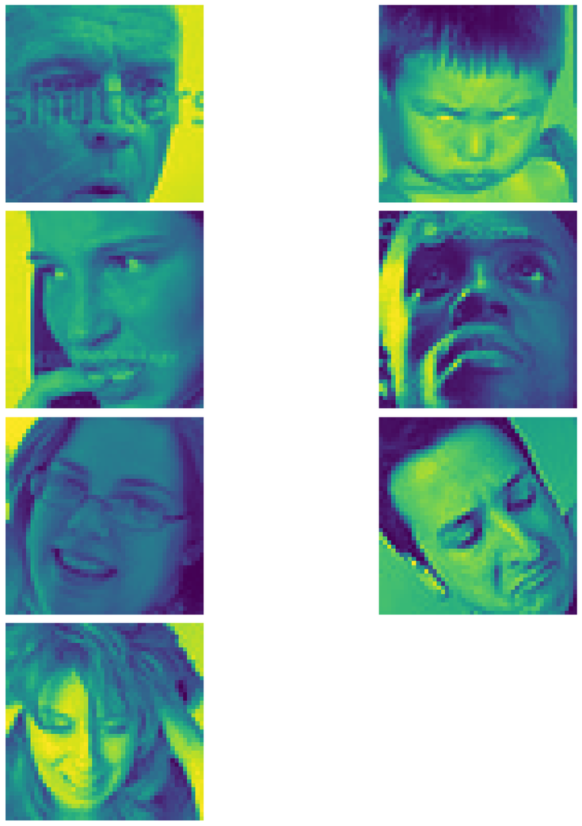

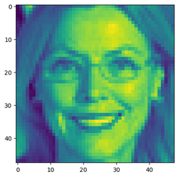
CNN
Results
5/8 62.5%
Surprise :: Surprise
Angry :: Angry
Fear :: Fear
Neutral :: Neutral
Happy :: Happy
Disgust :: Disgust
Sad :: Sad
Happy :: Happy

Slide 11
MobileNetV2
Results
1/8 12.5%
Surprise :: Fear
Angry :: Fear
Fear :: Fear
Neutral :: Happy
Happy :: Fear
Disgust :: Happy
Sad :: Fear
Happy :: Fear

Slide 12


CONCLUSION
Using the dataset from kaggle we were able to build a CNN and a MobileNetV2 model which is capable of recognizing the facial emotion of a user.
From the confussion matrix we saw that the first model does a good job in predicting most of the classes but the performance is comparatively lower in classes angry and fear. This might be caused due to fewer amount of data present for these classes.
From the confussion matrix we saw that the second model may predict happiness and surprise correctmy, but strugges to predict other emotions, this could to the usage of different input shapes in MobileNetV2 and it's necessaty to train on more Data than CNN.
Finally we tested both models using an image followed by an array of images, the CNN model predicted 5/8 pictures corrrectly which is not bad, getting results 62.5% correctly while the MobileNetV2 model predicted only 1/8 pictures, getting only 12.5% correctly.
CNN > MobileNetV2 in FER.

Slide 13
THANK YOU!

